Slide 1

ONE WEEK
DATA SCIENCE

Slide 2

BIAS VARIANCE TRADEOFF

Slide 3
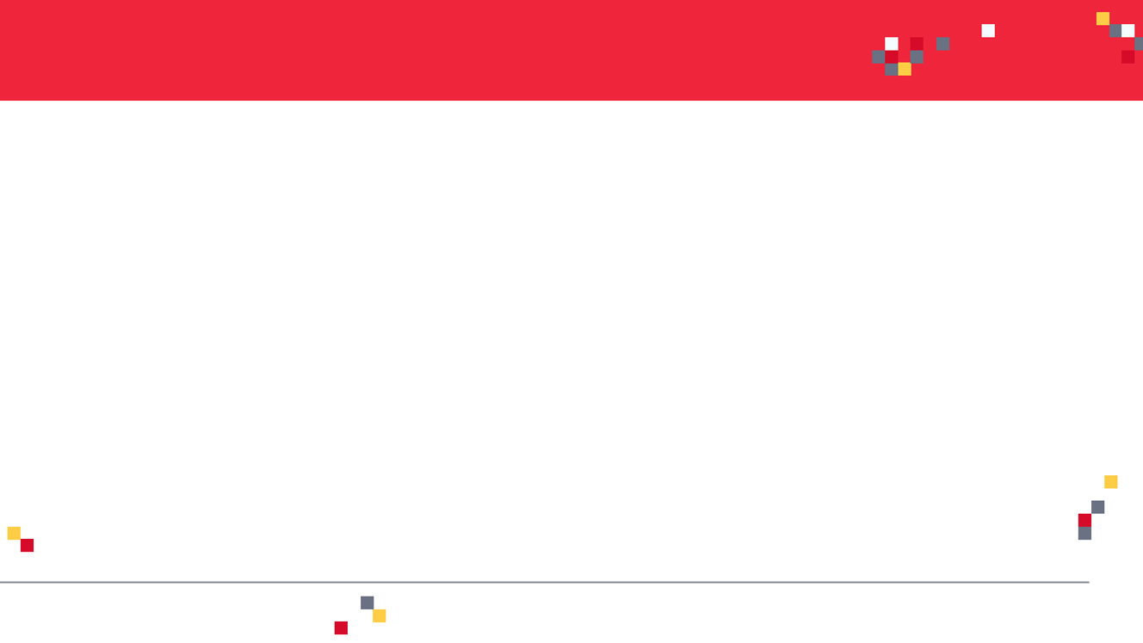
BIAS VARIANCE INTUITION
Let’s assume that we want to get the relationship between the Temperature and weekly sales.
As temperature increase, people tend to be happier and shop more.
This will likely increase the weekly sales.
As temperature goes beyond a certain limit, sales tend to plateau and they do not increase anymore.
PERFECT (TRUE) MODEL!
WEEKLY SALES
TEMPERATURE

Slide 4
BIAS VARIANCE TRAINING VS. TESTING DATASETS
Dataset is divided to training and testing datasets
Testing datasets have never been seen by the model before
WEEKLY SALES
TESTING DATASET
TRAINING DATASET
TEMPERATURE

Slide 5
BIAS AND VARIANCE: SIMPLE MODEL
Linear Regression model uses a straight line to fit the training dataset
Linear regression model lacks flexibility so it cannot properly fit the data (as the true perfect model does!)
The linear model has a large “bias” which indicates that the model is unable to accurately capture the true relationship between temperature and weekly sales.
PERFECT (TRUE) MODEL!
WEEKLY SALES
LINEAR REGRESSION MODEL
TRAINING DATASET
TEMPERATURE

Slide 6
BIAS AND VARIANCE: COMPLEX MODEL
PERFECT (TRUE) MODEL!
High order polynomial model is able to have a very small bias and can perfectly fit the training dataset.
High-order polynomial model is very flexible
WEEKLY SALES
HIGH ORDER POLYNOMIAL MODEL
TRAINING DATASET
TEMPERATURE

Slide 7


BIAS AND VARIANCE: MODEL #1 Vs. MODEL #2 DURING TRAINING
PERFECT (TRUE) MODEL!
PERFECT (TRUE) MODEL!
WEEKLY SALES
WEEKLY SALES
LINEAR REGRESSION MODEL
HIGH ORDER POLYNOMIAL MODEL
TEMPERATURE
TEMPERATURE
SUM OF SQUARES (LARGE)
SUM OF SQUARES (SMALL ~0)
THIS IS NOT THE WHOLE STORY!!

Slide 8
BIAS AND VARIANCE: MODEL #1 Vs. MODEL #2 DURING TESTING
PERFECT (TRUE) MODEL!
PERFECT (TRUE) MODEL!
WEEKLY SALES
WEEKLY SALES
LINEAR REGRESSION MODEL
HIGH ORDER POLYNOMIAL MODEL
TEMPERATURE
TEMPERATURE
SUM OF SQUARES (SMALL)
SUM OF SQUARES (LARGE)
The polynomial model performs poorly on the testing dataset and therefore it has large variance

Slide 9
MODEL COMPLEXITY VS. ERROR
Regularization works by reducing variance at cost of adding some bias to the model.
A trade-off between variance and bias occurs.
OPTIMUM MODEL
TOTAL ERROR
VARIANCE
ERROR
BIAS
MODEL COMPLEXITY
LINEAR
POLYNOMIAL

Slide 10
MODEL COMPLEXITY VS. ERROR
MODEL #1 (LINEAR REGRESSION) (SIMPLE) | MODEL #2 (HIGH ORDER POLYNOMIAL) (COMPLEX)
Model has High bias because it is very rigid (not flexible) and cannot fit the training dataset well | Model has small bias because it is flexible and can fit the training dataset very well.
Has small variance (variability) because it can fit the training data and the testing data with similar level (the model is able to generalize better) and avoids overfitting | Has large variance (variability) because the model over fitted the training dataset and it performs poorly on the testing dataset
Performance is consistent between the training dataset and the testing dataset | Performance varies greatly between the training dataset and the testing dataset (high variability)
Good generalization | Over fitted
Variance measures the difference in fits between the training dataset and the testing dataset
If the model generalizes better, the model has small variance which means the model performance is consistent among the training and testing datasets
If the model over fits the training dataset, the model has large variance
PERFECT REGRESSION MODEL SHALL HAVE SMALL BIAS AND SMALL VARIABILITY!
A TRADEOFF BETWEEN THE BIAS AND VARIANCE SHALL BE PERFORMED FOR ULTIMATE RESULTS

Slide 11
BASICS: L2 REGULARIZATION
(RIDGE REGRESSION)

Slide 12
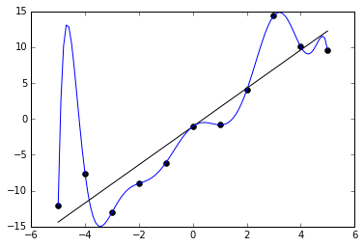
REGULARIZATION: INTUITION
Regularization techniques are used to avoid networks overfitting
Overfitting occurs when the model provide great results on the training data but performs poorly on testing dataset.
Overfitting occurs when the model learns all the patterns of the training dataset but fails to generalize.
Overfitted models generally provide high accuracy on training dataset but low accuracy on testing and validation (evaluation) datasets
Photo Credit: https://commons.wikimedia.org/wiki/File:Overfitted_Data.png

Slide 13
RIDGE REGRESSION (L2): INTUITION
Ridge regression advantage is to avoid overfitting.
Our ultimate model is the one that could generalize patterns; i.e.: works best on the training and testing dataset
Overfitting occurs when the trained model performs well on the training data and performs poorly on the testing datasets
Ridge regression works by applying a penalizing term (reducing the weights and biases) to overcome overfitting.
OVERFITTED MODEL
WEEKLY SALES
BALANCED/GENERAL MODEL
TEMPERATURE

Slide 14
RIDGE REGRESSION (L2): INTUITION
Least sum of squares is applied to obtain the best fit line
Since the line passes through the 3 training dataset points, the sum of squared residuals = 0
However, for the testing dataset, the sum of residuals is large so the line has a high variance.
Variance means that there is a difference in fit (or variability) between the training dataset and the testing dataset.
This regression model is overfitting the training dataset
WEEKLY SALES
TRAINING
DATASET
TESTING DATASET
TEMPERATURE

Slide 15
RIDGE REGRESSION (L2 REGULARIZATION): INTUITION
Ridge regression works by attempting at increasing the bias to improve variance (generalization capability)
This works by changing the slope of the line
The model performance might be little poor on the training set but it will perform consistently well on both the training and testing datasets.
RIDGE REGRESSION
TRAINING DATASET
LEAST SQUARES REGRESSION
WEEKLY SALES
TESTING DATASET
TEMPERATURE

Slide 16

RIDGE REGRESSION (L2 REGULARIZATION): MATH
Slope has been reduced with ridge regression penalty and therefore the model becomes less sensitive to changes in the independent variable (temperature)
RIDGE REGRESSION
LEAST SQUARES REGRESSION
PENALTY TERM
WEEKLY SALES
Least Squares Regression:
$$Min(sum of the squared residuals)$$
Ridge Regression:
$$Min(sum of squared residuals+ α ∗ slope^{2})$$
TEMPERATURE

Slide 17
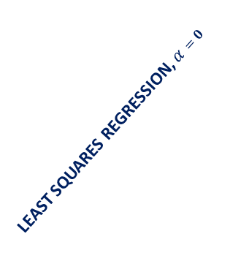
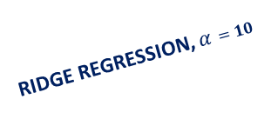
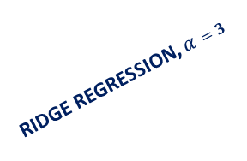
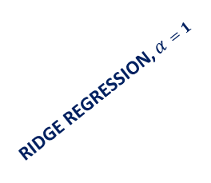
RIDGE REGRESSION (L2 REGULARIZATION): ALPHA EFFECT
As Alpha increases, the slope of the regression line is reduced and becomes more horizontal.
As Alpha increases, the model becomes less sensitive to the variations of the independent variable (Temperature)
RIDGE REGRESSION, $α=1$
LEAST SQUARES REGRESSION, $α=0$
RIDGE REGRESSION, $α=3$
WEEKLY SALES
RIDGE REGRESSION, $α=10$
TEMPERATURE

Slide 18
BASICS: L1 REGULARIZATION
(LASSO REGRESSION)

Slide 19
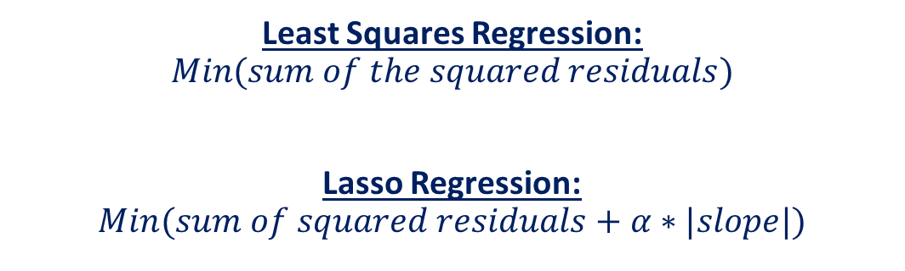
LASSO REGRESSION (L1 REGULARIZATION): MATH
Lasso Regression is similar to Ridge regression
It works by introducing a bias term but instead of squaring the slope, the absolute value of the slope is added as a penalty term
LASSO REGRESSION
LEAST SQUARES REGRESSION
PENALTY TERM
Least Squares Regression:
$$Min(sum of the squared residuals)$$
Lasso Regression:
$$Min(sum of squared residuals+α∗|slope|)$$
WEEKLY SALES
TEMPERATURE

Slide 20
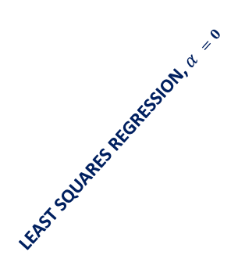
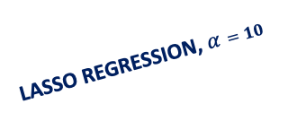
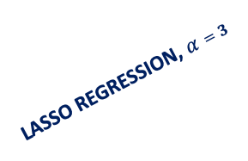
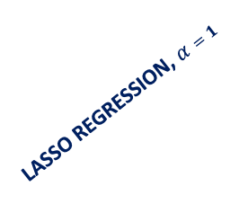
LASSO REGRESSION (L1 REGULARIZATION)
The effect of Alpha on Lasso regression is similar to its effect on ridge regression
As Alpha increases, the slope of the regression line is reduced and becomes more horizontal.
As Alpha increases, the model becomes less sensitive to the variations of the independent variable (Temperature)
LASSO REGRESSION, $α=1$
LEAST SQUARES REGRESSION, $α =0$
LASSO REGRESSION, $α=3$
LASSO REGRESSION, $α=10$
WEEKLY SALES
TEMPERATURE

Slide 21

LASSO REGRESSION: MATH
Lasso regression (L1 regularization) helps reduce overfitting and it is particularly useful for feature selection
Lasso regression (L1 regularization) can be useful if we have several independent variables that are useless
Ridge regression can reduce the slope close to zero (but not exactly zero) but Lasso regression can reduce the slope to be exactly equal to zero.
Least Squares Regression:
$$Min(sum of the squared residuals)$$
Ridge Regression (L2 regularization):
$$Min(sum of squared residuals+α∗ slope^{2})$$
Lasso Regression (L1 regularization):
$$Min(sum of squared residuals+α∗|slope|)$$

Slide 22
IN SUMMARY
L1 Regularization | L2 regularization
Used to perform feature selection so some features are allowed to go to zero | All features are maintained but weighted accordingly. No features are allowed to go to zero
When to choose L1?
If you believe that some features are not important and you can afford to lose them, then L1 regularization is a good choice.
The output might become sparse since some features might have been removed.
When to choose L2?
If you believe that all features are important and you’d like to keep them but weigh them accordingly.

